Slide 1
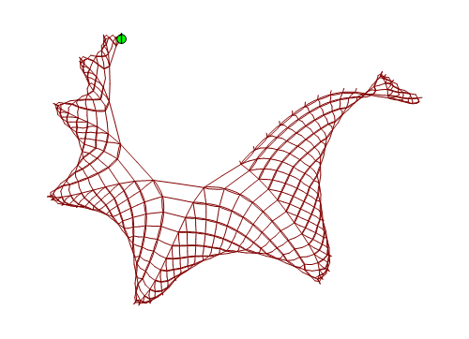
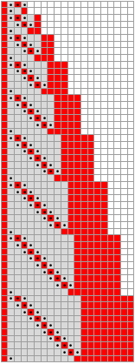
SESSIE NetWorks
Causal networks of SSSs
(Sequential Substitution Systems)
Pattern Hunting!

Slide 2
Simple Rules → Complex Behavior
Strategy:
Take all possible sets of simple rules
Apply them Look for complex behavior
Features similar to the real universe?

Slide 3
BUILDING SESSIES STEP BY STEP
Dr. Caviness
Jade Deschamps
3/16/2017

Slide 4

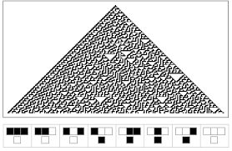
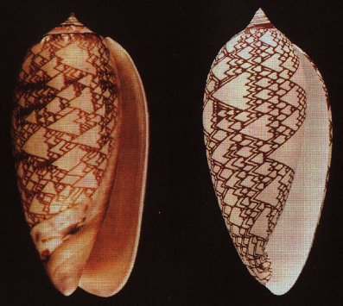
“On the frontier of complexity science since he was a boy, Wolfram is a champion of cellular automata--256 "programs" governed by simple nonmathematical rules. He points out that even the most complex equations fail to accurately model biological systems, but the simplest cellular automata can produce results straight out of nature--tree branches, stream eddies, and leopard spots, for instance. The graphics in A New Kind of Science show striking resemblance to the patterns we see in nature every day.” – Therese Littleton

Slide 5
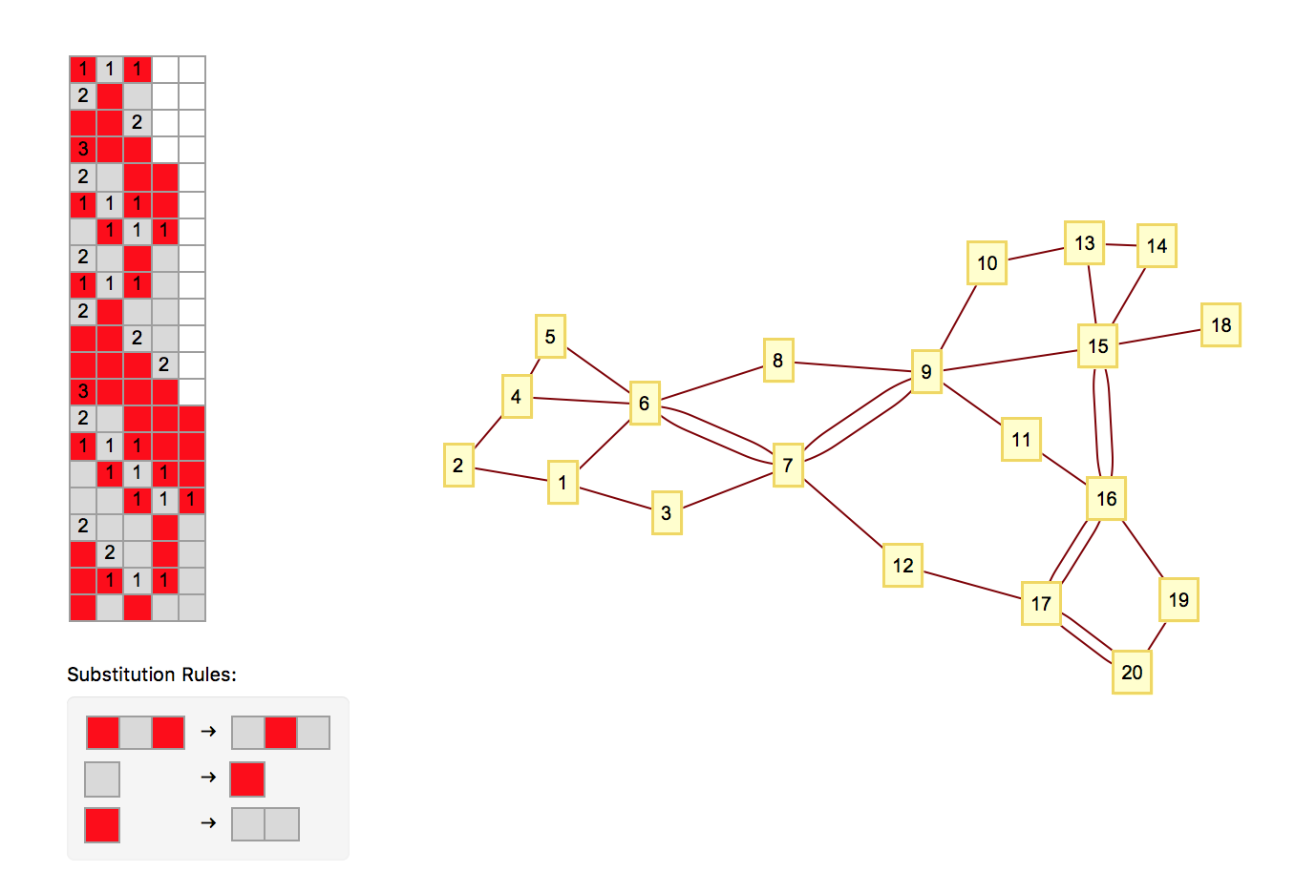
This is a “S.E.S.S.I.E” (Sequential Enumeration Substitution System)
Three Basic Components:
The “Sessie” (the gray and red grid)
The Rulesets
The Nodes (yellow boxes)

Slide 6
The 4 Basic Principles
1. Rules cause Sessies to change.
They destroy old blocks and exchange them for new blocks.
2. We read Sessies from left to right
3. We use only 1 rule per row, and
use the 1st row that works.
4. A Yellow Box means a rule was used.
Gray horizontal lines pair with yellow boxes. (How the boxes connect will be introduced later).
Sessie (aka a grid of cells)
Node 1
Node 2
Node 3
Node 4
And so on
Yellow box 1 w/ Node 1, Box 2 w/ Node 2… and so on.

Slide 7
You can start with any state string. This one is “BAB”. (Red-Gray-red corresponds to B-A-B)
This row matches Rule 1
Rule 1
We only use the first “substitution rule” that works.
Notes:
No rules used: only state string: no nodes

Slide 8
Numbers convey that Rule 1 matched with these cells
rule applications occur “between” rows
1 Rule application → creates 1 node
Exchanging the old row, for this new one below it.
Node 1
Rule 1
Notes:
1 node from 1 rule used

Slide 9
Node 2
Which rule would we use next?
Why are they connected?
Node 2
When new node exchanges the blocks of an old node, a line links the nodes!
Implications:
Let’s say a new node destroyed 3 older blocks, but, these blocks came from 3 different nodes. How many links would the new node have?
Notes:
2 rules used: 2 connected nodes
CONNECTED – 1 cell created by event 1, destroyed by event 2
Identify: what rule was used in row 2? - second rule (see “2” in row 2)
→ Single connection

Slide 10


Node 1
Node 2
Node 3
Rule 2
So, given , what rule would we use for Node 3?
Remember:
Read Sessie L from R
Use the first rule that works
Applying this rule “creates” node 3.
Rule 2
Notes:
2 rules used: 2 connected nodes
CONNECTED – 1 cell created by event 1, destroyed by event 2
Identify: what rule was used in row 2? - second rule (see “2” in row 2)
→ Single connection

Slide 11
Rule 2
If node 1 created a block,
and node 3 replaced that block,
then they must be connected.
T
This is this is the basic premise of building Sessies.
Notes:
Identify- nodes 1 and 3 are connected.

Slide 14
3 Links at once!!
See “ 1 1 1”
Let’s go back to our previous implication:
“Let’s say a new node destroyed 2 older blocks, but, these blocks came from two different nodes. How many links would the new node have?”
Notes:
Row 6: 1 1 1 : replaced 3 nodes that were originally formed from 3 different places

Slide 16
Here we have Node 7 connected twice to Node 6. Why might that be?
Simply because Node 7 exchanged two block from Node 6.
Notes:
6 created 2 cells that 7 destroyed: therefore, 2 connections.
Let’s find them on the sessie grid.

Slide 29
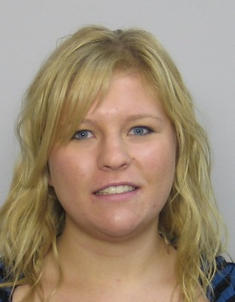
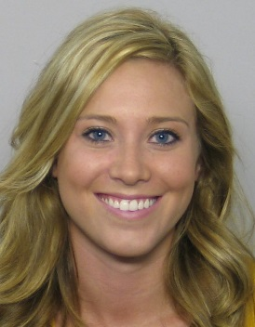
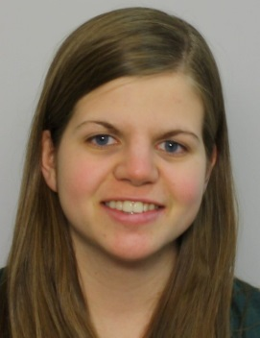
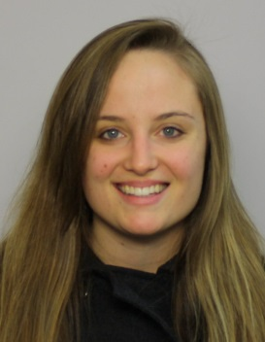
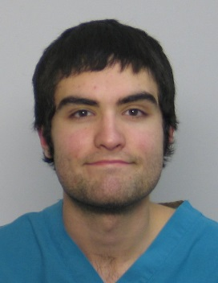
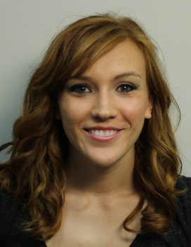
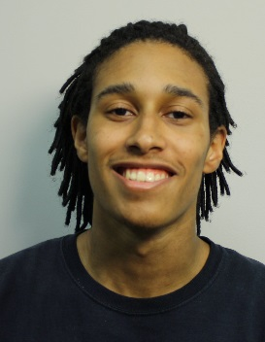
Human inspection of networks
Breanna Bowden-Green (ENGR, W11)
Kelsey Dobbs (ENGR, W10)
Mathematical treatment of network properties
Amy Beard (MATH, W12)
Improved enumeration & acceleration
Christen Case (CHEM/MATH, F14)
Programmatic identification of dimension
Lucas Valenca, Camille Morrow, Drew Blake, ?
Research stages

